Slide 1
AnyCut Process
Why, What and How.
Notes:
Hallo.
I am very happy to be here.
Today we will talk about why we upgraded Cut Format types.
What you can achieve with this upgrade.
And how to solve typical problems.

Slide 2
Part 1.
Why we created Goodwin and Smart Cuts
Advantages and usecases

Slide 3
Cut Format types
Legacy Upgrade
ASCII | Goodwin
DLL | Smart Cut
Notes:
We will talk about 4 following Cut format types.
Two legacy Cut format Types: ASCII and DLL.
And two new Cut types: Goodwin and Smart Cut.

Slide 4

Goodwin as ASCII upgrade
# | Feature | ASCII | Goodwin
1 | Control of Basic cut parameters (RT, Ch, Pd, Tb) | Yes | Yes
2 | Control of Slopes (Ca, Pa1, Pa2) | No | Yes
3 | Independent tiers variation for Pavilion | No | Yes
4 | Girdle outline variation | No | Yes
Goodwin Advantages example
Notes:
Goodwin is an advanced implementation of ASCII cut.
You can check Goodwin demo sample using QR code.
I will show you what advantages Goodwin cuts have in HPC.
With Goodwin use can control and vary slopes. See how we can change slope for pavilion tier 1 and tier 2 for this cushion.
That is not possible with ASCII cuts.
Also with Goodwin it is possible to change girdle outline.
QR code https://octonus-teams.com/wiki/display/HPCDPUB/Goodwin+fancy+color+example
Show this in HPC.

Slide 5

Smart Cuts as DLL upgrade
# | Feature | DLL | Smart Cut
1 | Extensive set of generic cut parameters | Yes | Yes
2 | Smart Recut | No | Yes
3 | Plug-and-play Profiles | No | Yes
4 | Sweet Line | No | Yes
5 | Appraiser edit via GUI | No | Yes
Smart Cuts Special Profiles video
Notes:
SmartCut is the advanced implementation of DLL cut.
It takes best features of DLL cuts and adds many other features such as seamless Smart Recut, Plug-and-Play profiles etc that makes SmartCuts really easy-to-use cuts.
You can check video on SmartCuts using this QR code.
QR code https://www.youtube.com/watch?v=NwSUy2QyhLk&list=PLdYcfyGTni-GHUJbulsXFfftha-VbPmQF&index=14&ab_channel=OctonusOfficialChannel

Slide 6
Use cases for Smart Cuts and Goodwin Cuts
# | Case | Goodwin | Smart Cut
1 | DLL was used previously and DLL has the desired pattern | - | Use
2 | DLL for the required pattern is not available (for example Special cuts) | Use | -
3 | It is required to get allocation for a defined set of proportions (with 10-100 preforms) | Use | -
4 | You are starting with allocation and DLL has the desired pattern | See next slide
Notes:
What are major Use cases for Smart Cuts and Goodwin cuts:
1) If you previously worked with DLL cuts – then upgrade to SmartCuts for additional SmartCuts features.
You can manually transfer parameter limits from DLL TXT appraiser to SmartCut GUI appraiser.
2) If SmartCut or DLL is not available for desired pattern – you can go for Goodwin.
3) If you require allocation for defined set of proportions – also go for Goodwin.
4) If you are starting with allocation…

Slide 7
Suggested Process
# | Description
1 | Use Smart Cut as a default easy-to-use option. It does not require preforms from the Client and can vary Girdle Outline for additional Yield
2 | Accumulate the set of Good Preforms as per Client requirements during the diamond processing
3 | Use these preforms to create Goodwin cut that will produce solutions as per Client requirements
Notes:
This is the suggested process flow.
Smart Cut is the easiest point to start. It does not require preforms from the client. One can use plug-and-play profiles.
Process the stones and accumulate scans for Good stones as per your requirements.
Once you have extensive set of preforms – use it to create Goodwin cut.

Slide 8
PerformanceWare for Fancy Shapes
Smart Cut
Goodwin
Facetware-type appraisers (PerformanceWare) for Fancy Shapes with direct control of the plan Performance: Brilliance, Fire, and Scintillation
The Scintillation metric is coming soon on Cutwise
Notes:
We are working on the combination of SmartCut + Goodwin preforms.
This will allow the creation of Facetware-type appraisers (PerformanceWare) for Fancy Shapes with direct control of the plan Performance
Previously we implemented Fire and Brilliance metrics.
The Scintillation metric is coming soon on Cutwise.

Slide 9
Part 2.
List of typical errors that limits the allocation results
Notes:
I visited 5 factories. Operators face with the following typical problems.

Slide 10
List of Typical Errors
# | Typical Error | ASCII | Goodwin | Smart Cut
1 | Facet Types are not correct
2 | Starting form is outside the EX range
3 | Only the Absolute part of the appraiser is used
4 | Sweet Line is not used
5 | Cut contains only a single preform
6 | MyAnyCut appraiser utilization instead of more advanced Appraisers linked to separate cuts
7 | 20 Single (Recut) used instead of more advanced for Goodwin cuts 22 Single (Recut)
8 | Cuts any appraisers are not synchronized between operators
Notes:
Unfortunately I do not have the same stones and project that I saw in the factories.
And I have limited time for presentation.
So I prepared several demo examples that will show typical errors. And what could be achieved by fixing it.

Slide 11
Part 3.
Examples
Notes:
Let’s start.
I will show some slides in presentation along with HPCarbon software and Cutwise projects.

Slide 12
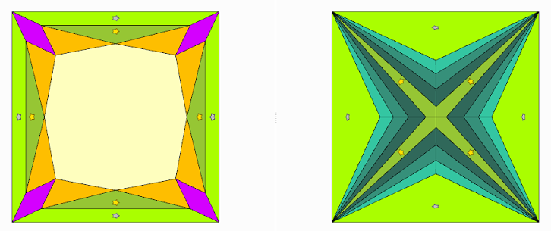
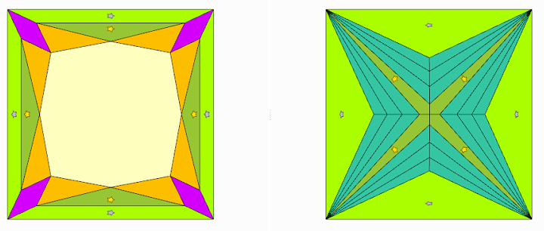
Demo 1. Facet Types are not correct
Correct Facet Types Wrong Facet Types
Shevrons are marked with SubTypes
Shevrons are marked with Same Type
Notes:
One of the most common problems – wrong Facet types.
We will take Goodwin Princess as an Example.
On the left correct facet types are shown.
On the right – shevrons are marked with the same type.
So the software will try to make equal slopes and azimuths for these facets.

Slide 13
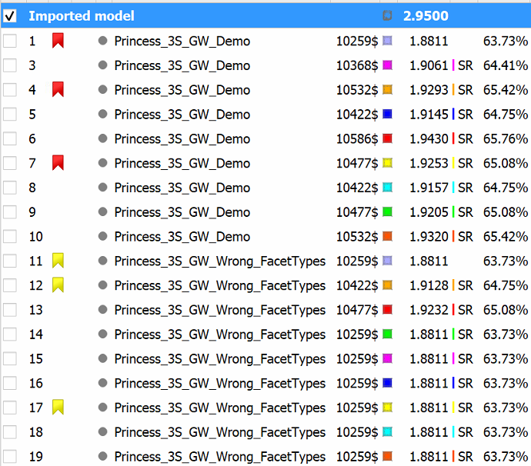

Demo 1. Facet Types are not correct
Correct Facet Types
Wrong Facet Types
Demo 1. Facet Types
Notes:
We can see that Recut solutions are same in current case.
Facet Types affect SmartRecut solutions.
Let’s compare several solutions on Cutwise. I preuploaded this solutions before the Presentation.
You can check Cutwise project using QR code on the right.
QR to project https://cutwise.com/projects/5e0329ad-35f9-44bd-bd48-c4f0e729ba74/solutions?sort=79GLbHdewmcNM4MiBmPzUVbBkSykvWfBrn3

Slide 14
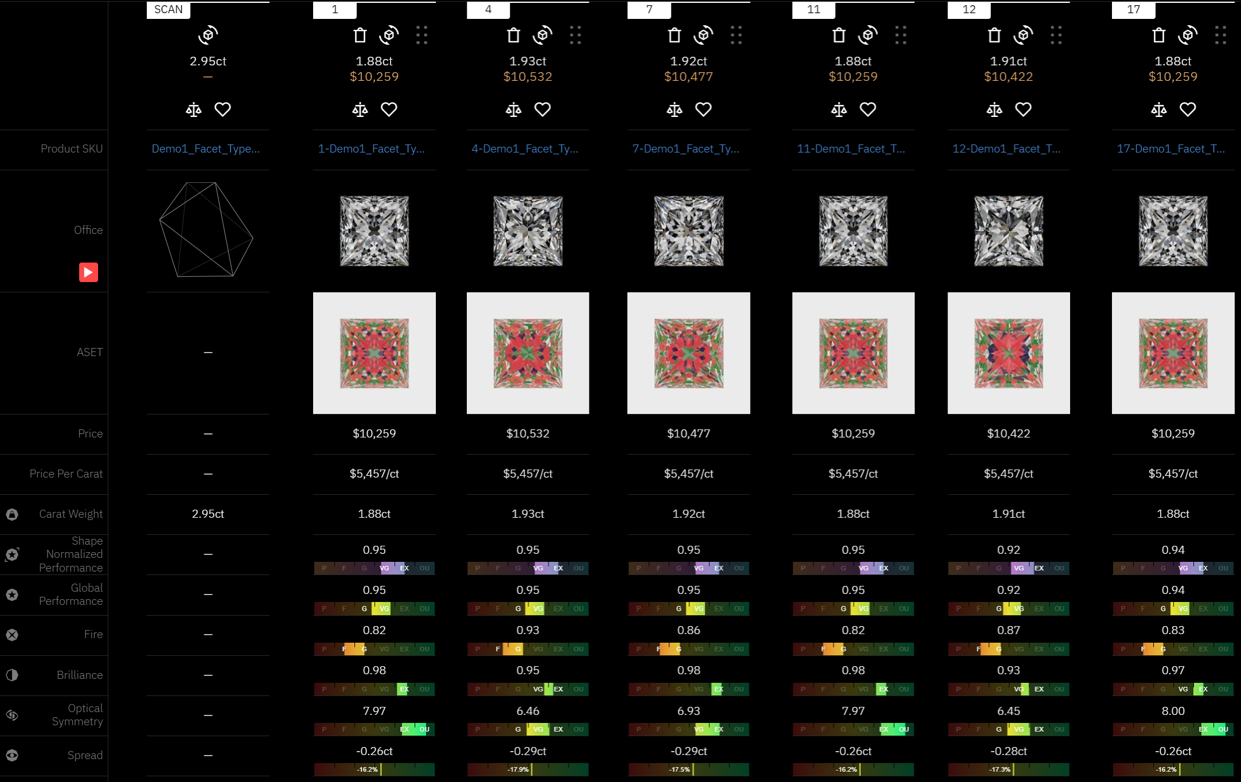
Demo 1. Facet Types are not correct
Correct Facet Types | Wrong Facet Types
Demo 1. Facet Types
Notes:
SR Solutions with Correct Facets types wins both by weight and Performance.
Why this is happened – let’s compare solution 4 and 12 form the same SmartRecut preset.
Show it HPC.
Solution 12 has shevron facets with very close slopes and azimuths so shevrons do not work as intended.
This is happened because we marked these shevrons as same facet type.

Slide 15

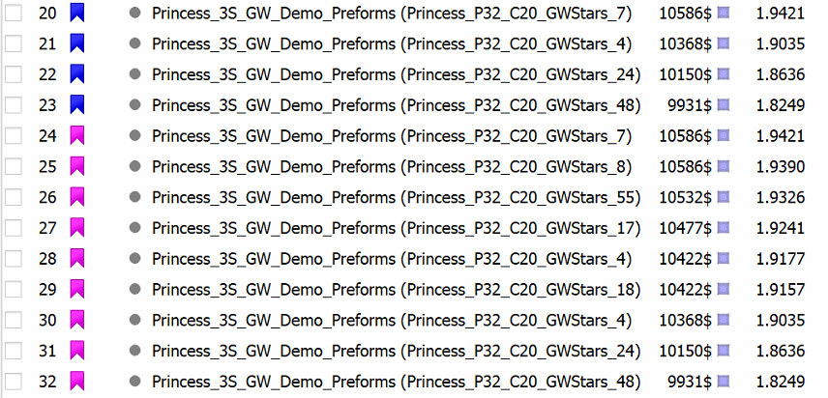
Demo 2. 20 Single (Recut) vs 22 Single (Recut)
20 Single (Recut)
22 Single (Recut)
Demo 2. 20 Single (Recut) vs 22 Single (Recut)
20 Single (Recut) gives 2 options between 1.94 and 1.90.
While 22 Single (Recut) gives 7 options in same range made with different preforms.
Notes:
We will proceed with the Goodwin Princess as an Example.
We will compare the results of 20 Single (Recut) vs 22 Single (Recut) for same Rough.
20 Single (Recut) gives 2 options between 1.94 and 1.90.
While 22 Single (Recut) gives 7 options in same range made with different preforms.
QR code to the project: https://cutwise.com/projects/cb60a541-171f-4ba9-92a0-02f5e2d66459/solutions?sort=qbPmvINV4OcM92kCRA9biMow0Cb9p3SkjzXS7WBeI1MkYF03pK

Slide 16
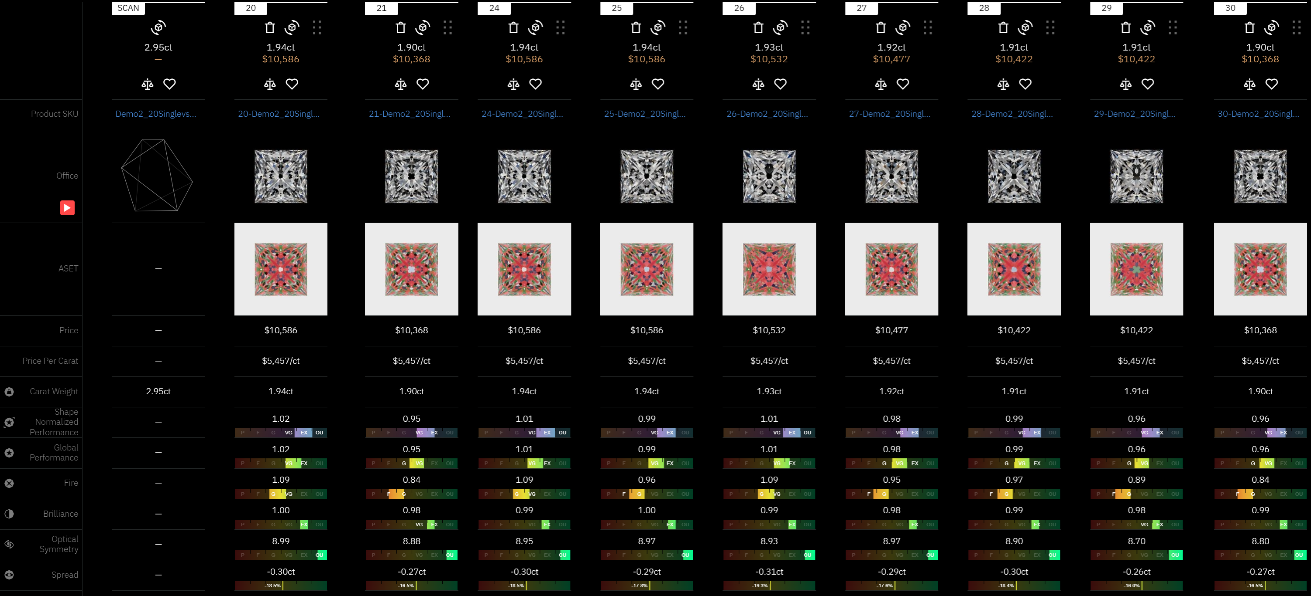
Demo 2. 20 Single (Recut) vs 22 Single (Recut)
22 Single (Recut)
20 Single (Recut)
Demo 2. 20 Single (Recut) vs 22 Single (Recut)
Notes:
You can see that latest algorithm gives you more options to choose from. For example you can go for solution 24 or 26.
And then run SmartRecut.
You can check Cutwise project using QR code on the right.
QR code to the project: https://cutwise.com/projects/cb60a541-171f-4ba9-92a0-02f5e2d66459/solutions?sort=qbPmvINV4OcM92kCRA9biMow0Cb9p3SkjzXS7WBeI1MkYF03pK

Slide 17
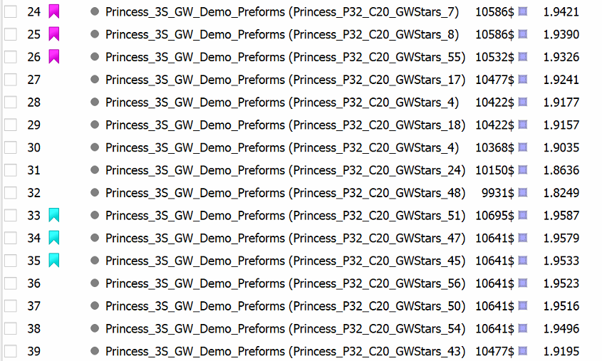

Demo 3. Absolute vs Absolute+Relative Appraiser
Absolute+Relative
Absolute Only
Demo 3. Absolute vs Abs+Rel Appraiser
Notes:
We will continue with the Goodwin Princess.
Previously we used 22 Single (Recut) with Absolute+Relative appraiser. Now let’s check the results for 22 Single (Recut) with Absolute only Appraiser.
Let’s analyze first 3 solutions of every type.
We see that Absolute only gives slightly bigger Yield.
Let’s check solutions on Cutwise. You can check the project using QR code.
QR code to the project: https://cutwise.com/projects/3e575c58-4afd-49b7-8325-eaf611244815/solutions?sort=G6AErI9RayHZvwMF0jGbtRdkksyKrLhqydx

Slide 18
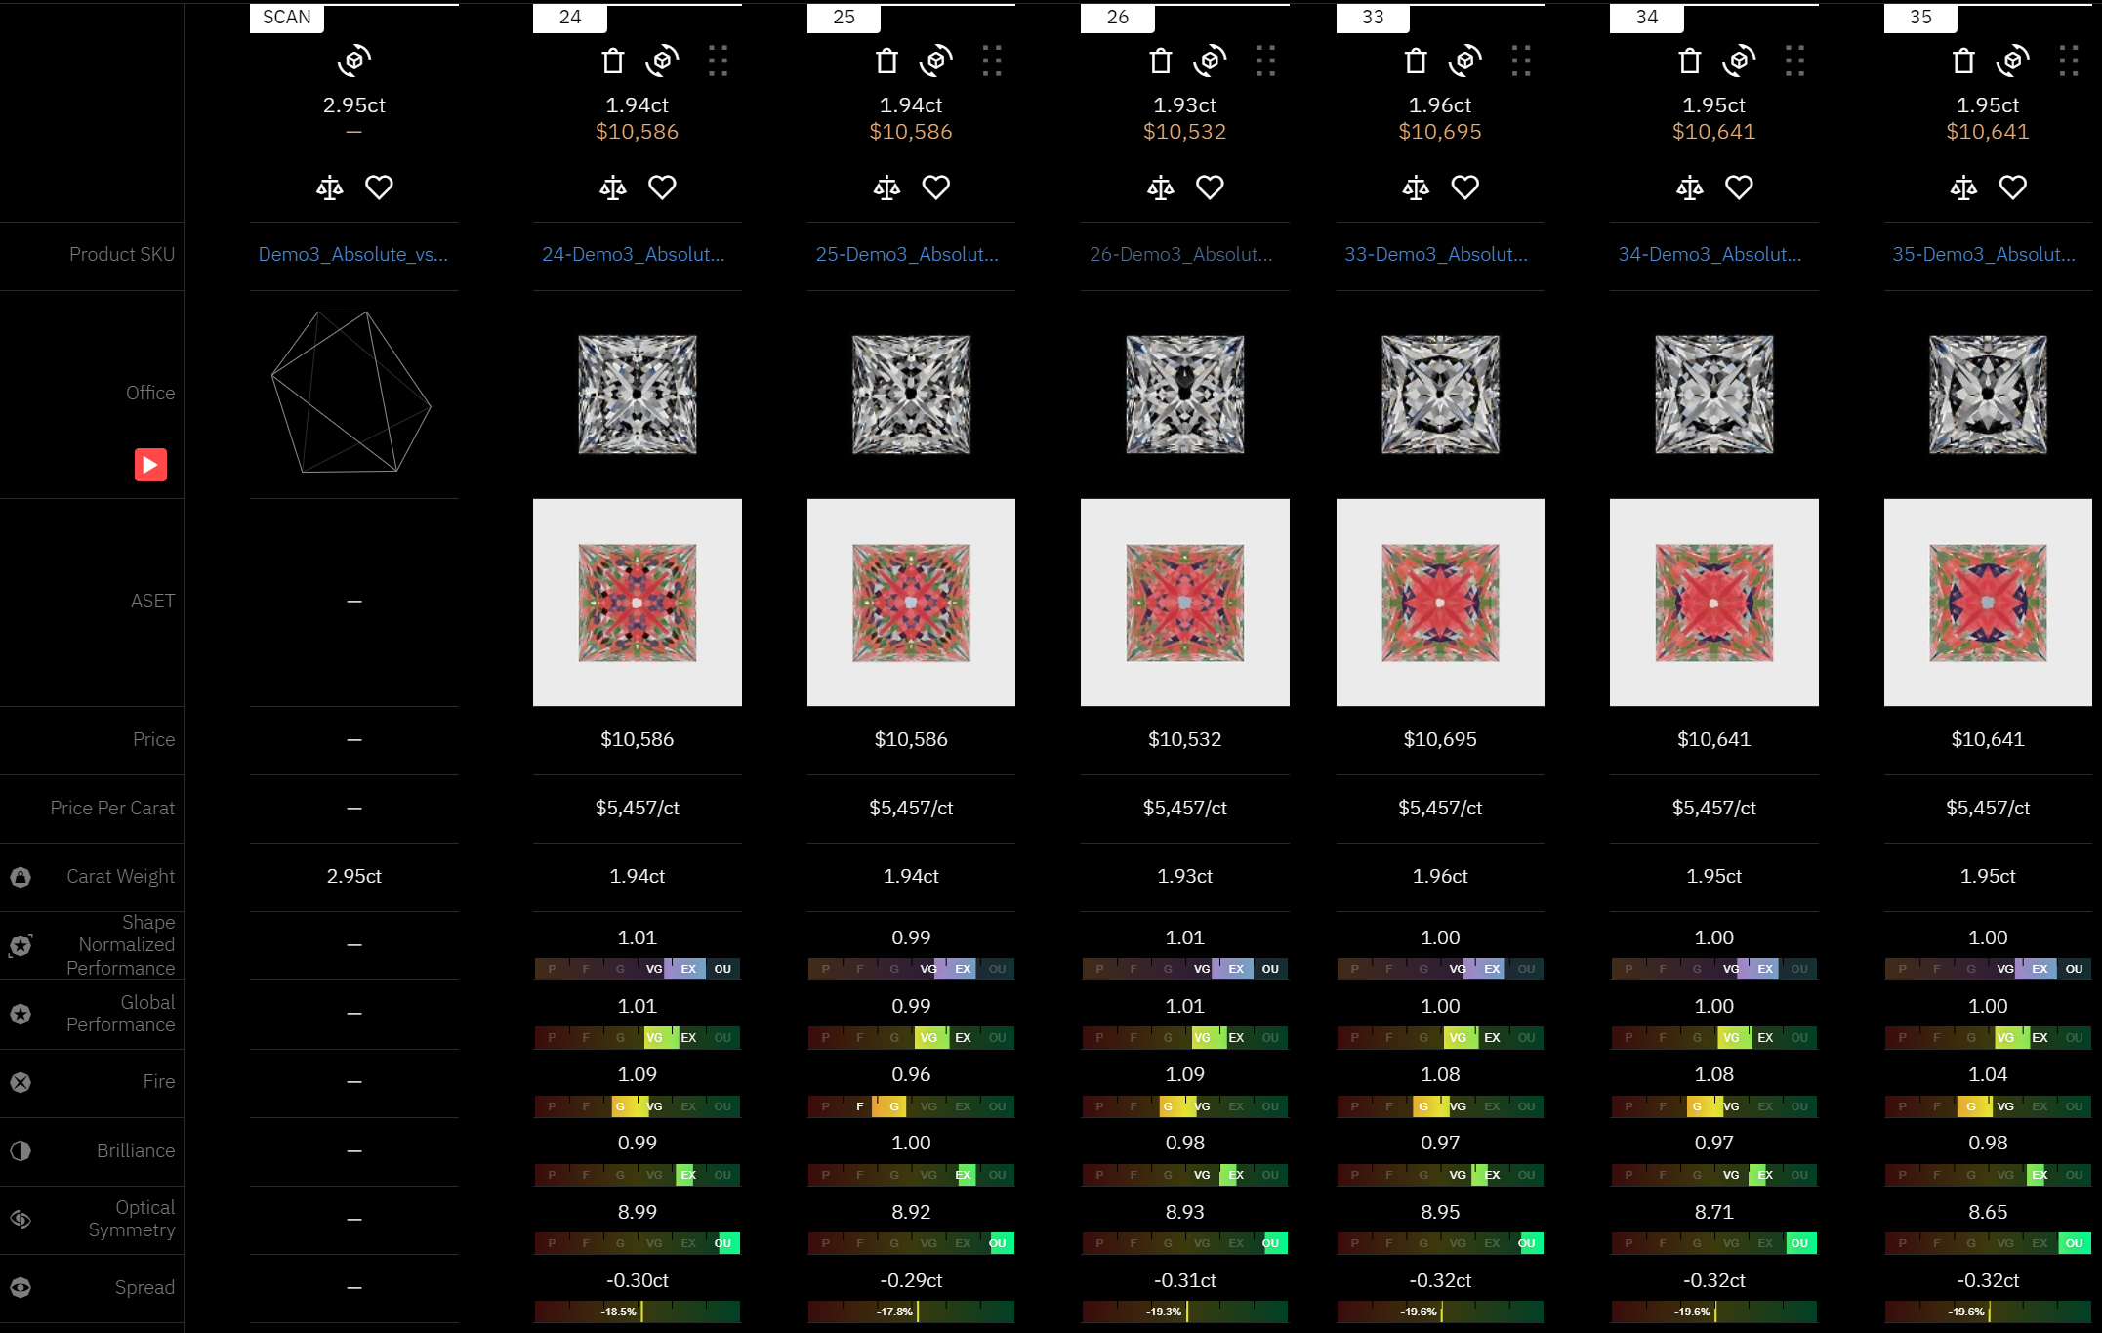
Demo 3. Absolute vs Absolute+Relative Appraiser
Absolute Only
Absolute+Relative
Demo 3. Absolute vs Abs+Rel Appraiser
Notes:
We see that Absolute Only allocation usually gives results with lower performance.
Why it is happened.
Let’s compare solutions 24 and 33.
QR code to the project: https://cutwise.com/projects/3e575c58-4afd-49b7-8325-eaf611244815/solutions?sort=G6AErI9RayHZvwMF0jGbtRdkksyKrLhqydx

Slide 19
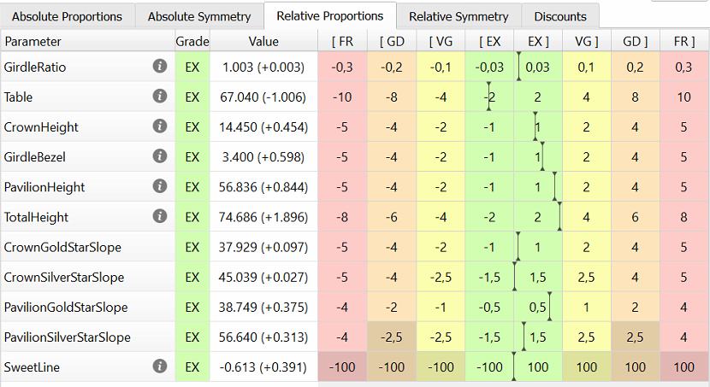
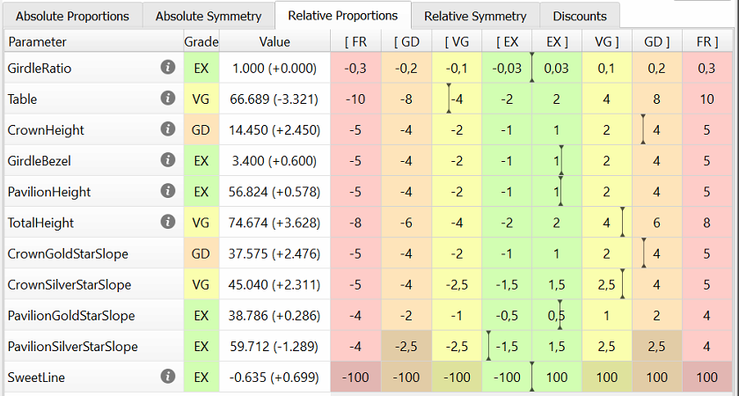
Demo 3. Absolute vs Absolute+Relative Appraiser
Absolute Only. Solution 33
Absolute+Relative. Solution 24
Demo 3. Absolute vs Abs+Rel Appraiser
Notes:
Let’s compare solutions 24 and 33.
In Relative part of the appraiser we can see the difference of the selected solutions from the Goodwin Preform.
Solution 24 has Crown height difference 0.45, Pavilion depth 0.84
On the other hand Solution 33 has Crown height difference 2.45, Pavilion depth 0.58
QR code to the project: https://cutwise.com/projects/3e575c58-4afd-49b7-8325-eaf611244815/solutions?sort=G6AErI9RayHZvwMF0jGbtRdkksyKrLhqydx

Slide 20
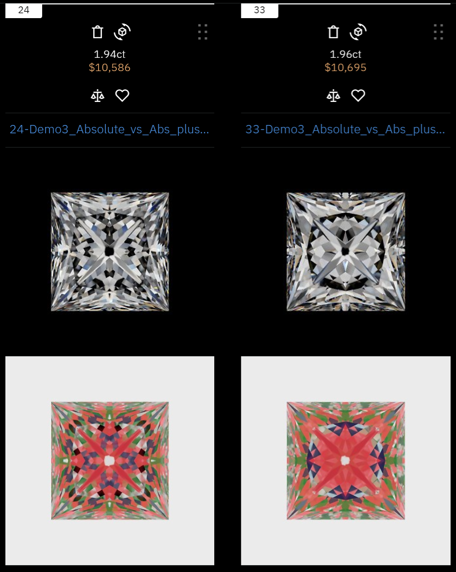
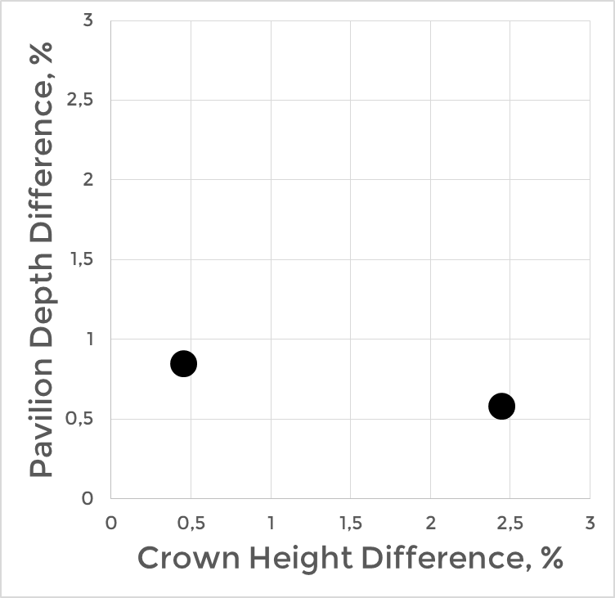
Demo 3. Absolute vs Absolute+Relative Appraiser
Absolute+Relative. Solution 24
Absolute Only. Solution 33
Demo 3. Absolute vs Abs+Rel Appraiser
Notes:
If the solution is close to the Preform by parameters it will be also close by Performance.
If the solution is far from the dedicated Preform – it could be very different from the preform by Performance.
This effect we observe here. Solution 24 is closer to the preform by Performance and solution 33 is far from the preform.
QR code to the project: https://cutwise.com/projects/3e575c58-4afd-49b7-8325-eaf611244815/solutions?sort=G6AErI9RayHZvwMF0jGbtRdkksyKrLhqydx

Slide 21
Demo 3. Absolute vs Absolute+Relative Appraiser
Absolute
Relative
Absolute+Relative appraiser produces solutions with Performance close to Preforms. It works best for Goodwin cuts with multiple Preforms selected by Performance.
Absolute only appraiser can produce higher Yield, but compromise Performance. It can be used for Single Preform Goodwin cuts or for Max Mass allocation.
Demo 3. Absolute vs Abs+Rel Appraiser
Notes:
QR code to the project: https://cutwise.com/projects/3e575c58-4afd-49b7-8325-eaf611244815/solutions?sort=G6AErI9RayHZvwMF0jGbtRdkksyKrLhqydx

Slide 22

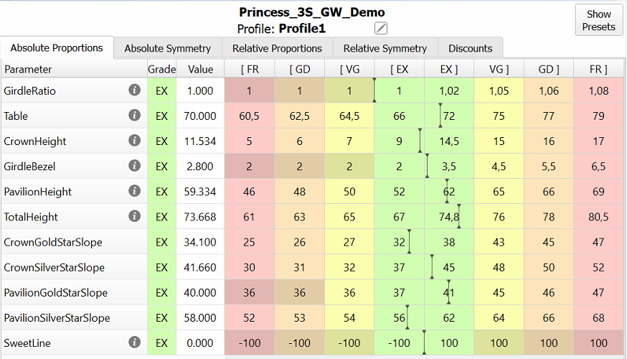
Demo 4. Starting Form is outside the EX range
Operator wants to change Total Height limitation for EX range from 67-74.8 to 67-72%
Demo 4. Starting form outside the EX range
Notes:
Operator can modify Parameter limits in the Profiles as per Factory requirements
In some cases this leads to Starting Form falling outside the new EX range
This can affect allocation process for EX as algorithms may be not able to return the solution to the EX group.
For example – Operator wants to change Total Height for EX range. And limit it to 72%
.
QR code to the project: https://cutwise.com/projects/2b4887ee-5fd5-4987-b803-404cf0969c59/solutions?sort=WwK9RuNpb2CoAa7tpyQBSdjnEijY4OUA1wx

Slide 23
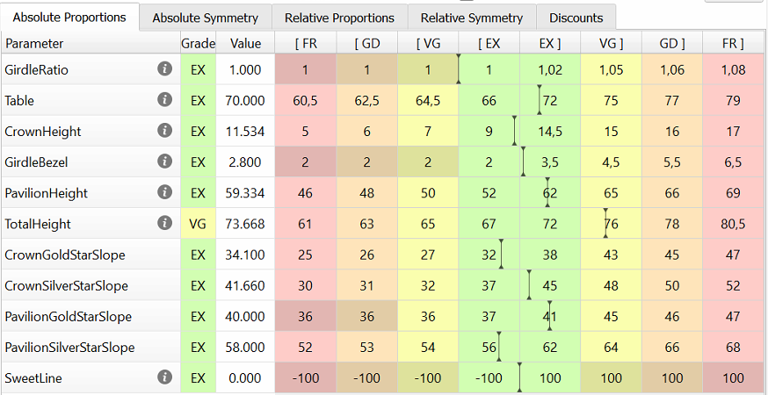
Demo 4. Starting Form is outside the EX range
Starting Form has Total Height of 73.67%, so it falls out of EX group and became VG
Demo 4. Starting form outside the EX range
Notes:
Now Starting form falls out of EX range.
QR code to the project: https://cutwise.com/projects/2b4887ee-5fd5-4987-b803-404cf0969c59/solutions?sort=WwK9RuNpb2CoAa7tpyQBSdjnEijY4OUA1wx

Slide 24
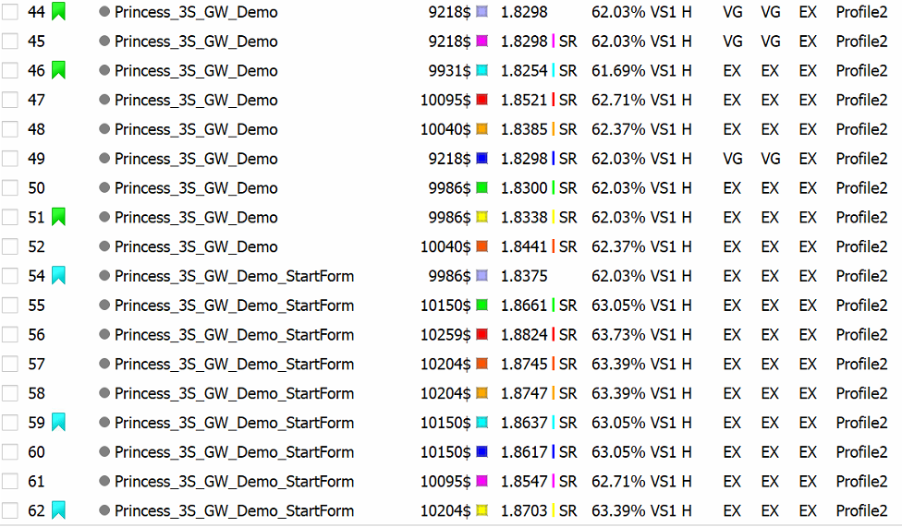
Demo 4. Starting Form is outside the EX range
Start Form Outside EX Range
Start Form in EX Range
Demo 4. Starting form outside the EX range
Notes:
In case of Starting form outside EX range – Recut Solution can remains outside EX range. Recut will work as Fixed Form algorithm.
In case of Starting form in EX range – Recut will change cut parameters.
Let’s check selected Recut and SR solutions on Cutwise.
QR code to the project: https://cutwise.com/projects/2b4887ee-5fd5-4987-b803-404cf0969c59/solutions?sort=WwK9RuNpb2CoAa7tpyQBSdjnEijY4OUA1wx

Slide 25
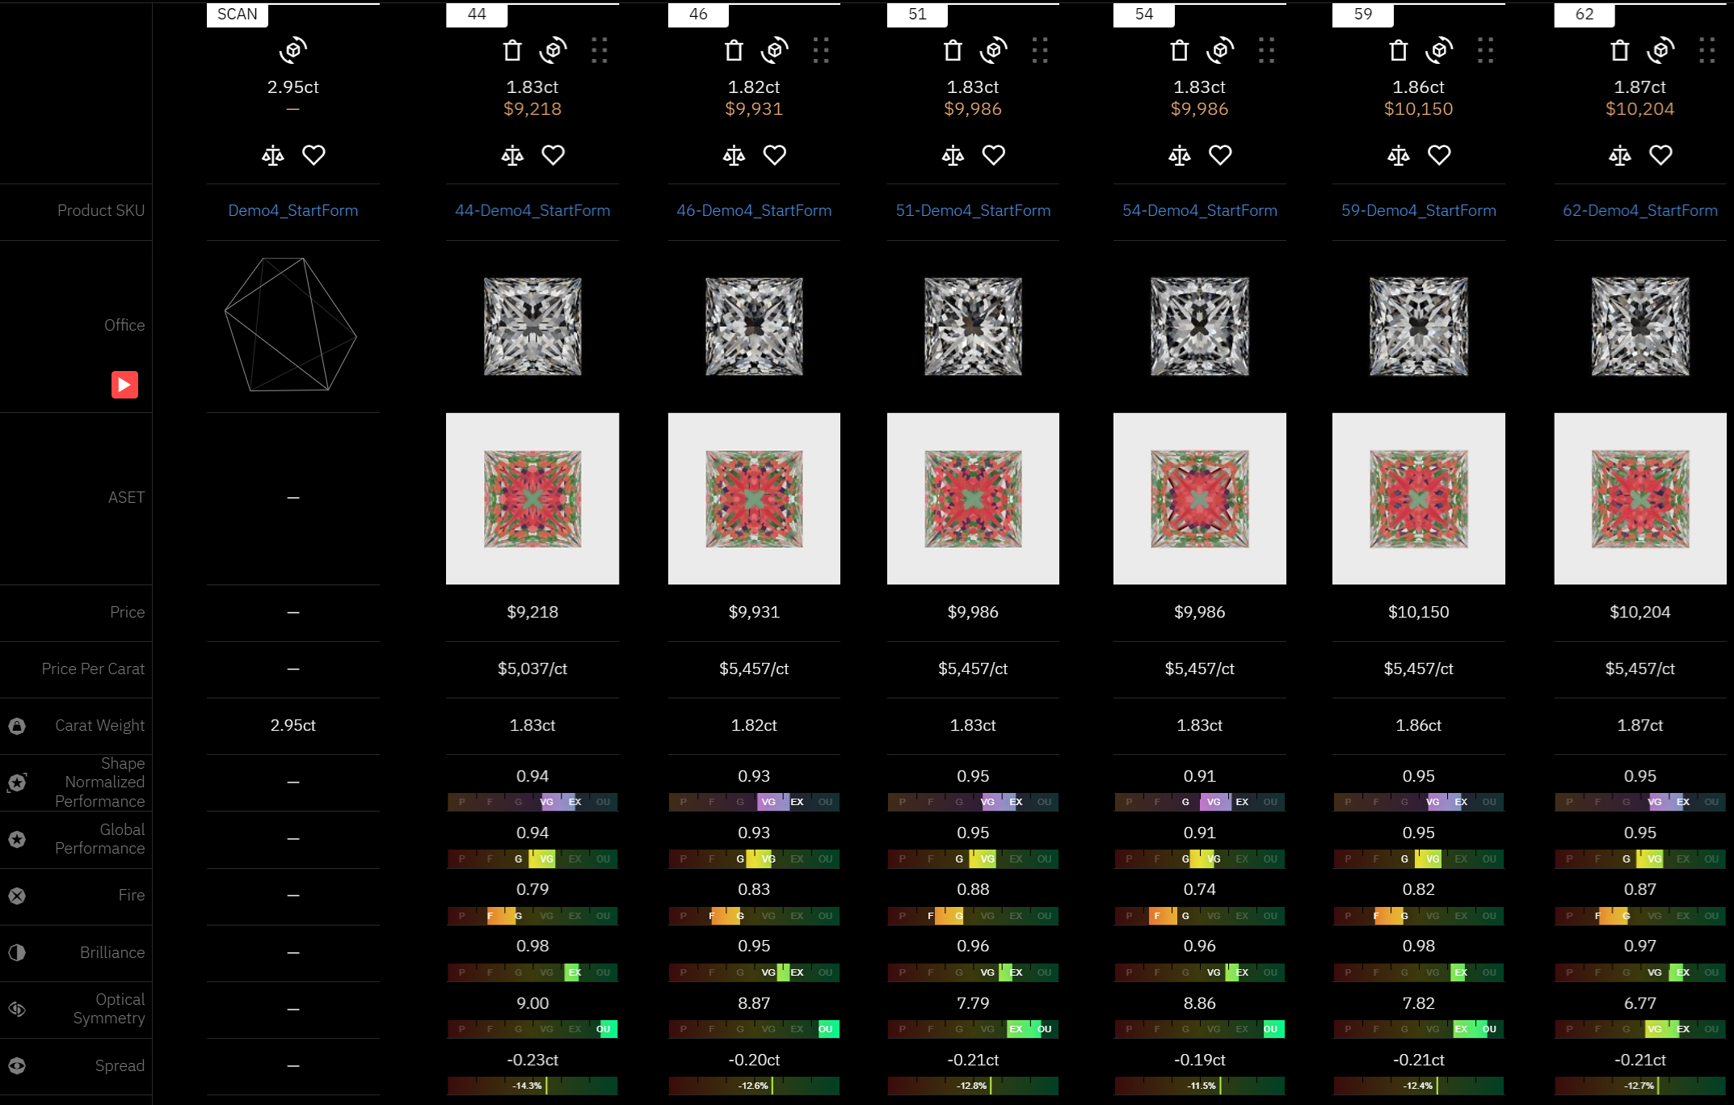
Demo 4. Starting Form is outside the EX range
Start Form Outside EX Range
Start Form in EX Range
Demo 4. Starting form outside the EX range
Notes:
In case of Starting form in EX range – SR solutions have better Yield and Performance.
In case of Starting form outside the EX range – SR may return the solutions in EX range, but since the starting VG solution was not optimal – then SR solutions also will be not optimal.
QR code to the project: https://cutwise.com/projects/2b4887ee-5fd5-4987-b803-404cf0969c59/solutions?sort=WwK9RuNpb2CoAa7tpyQBSdjnEijY4OUA1wx

Slide 26
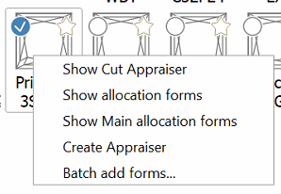
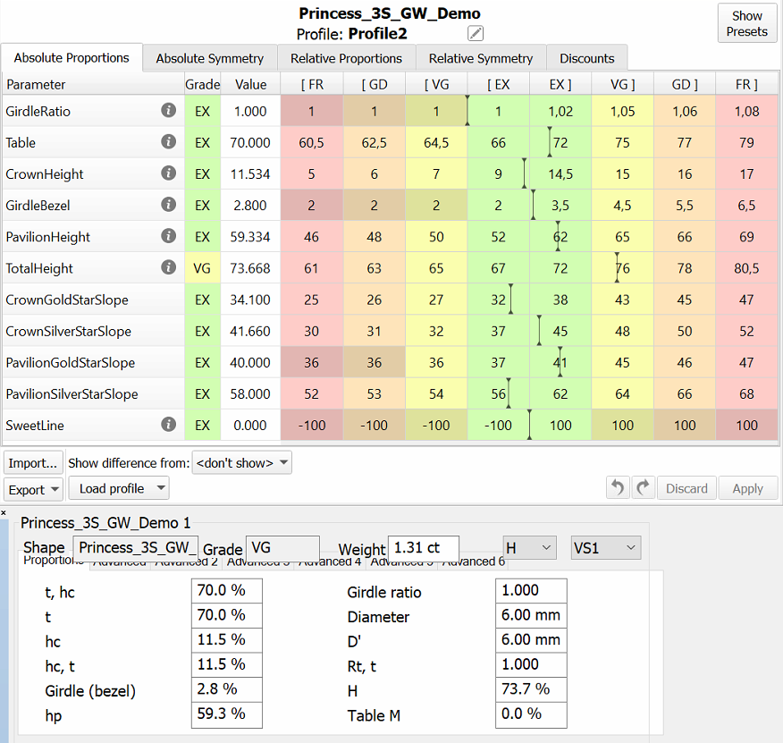
Demo 4. How to Modify the Starting Form
Use Show allocation forms button to see the allocation forms for particular Cut
Open the Appraiser and Parameters panel
Modify the Starting Form parameters to fit it into the EX group
Save the resulting form as a new preform
Demo 4. Starting form outside the EX range
Notes:
How to modify the starting form and return it to the EX range.
QR code to the project: https://cutwise.com/projects/2b4887ee-5fd5-4987-b803-404cf0969c59/solutions?sort=WwK9RuNpb2CoAa7tpyQBSdjnEijY4OUA1wx

Slide 27

Sweet Line usage
SweetLine approach is widely used for RBC and can be applied to Fancy Cuts
Video on Sweet Line in RBC
Video on Sweet Line in SmartCuts
Notes:
Unfortunately we have limited Time.
So we will not discuss SweetLine approach today.
You can check the video regarding SweetLine in Rounds.
Generally for Fancy Shapes approach will be similar.
QR code to the video on RBC SL
https://www.youtube.com/watch?v=hb6O87p_Ip4&list=PLdYcfyGTni-GHUJbulsXFfftha-VbPmQF&index=5&ab_channel=OctonusOfficialChannel

Slide 28
Part 4.
How to request Cut improvement
Notes:
We receive many request regarding new parameters in Cuts.

Slide 29
How to Request Cut Improvement
Please start with “Why” and “What”:
  Real examples where allocation gives bad Performing cuts
  What exact features are considered negative
  What result would be good
We can work together on “How” via Appraiser modification or new parameters implementation
Thank you!
Notes:
Please start your requests with “Why”.
Show real examples and what you consider to be good and bad result.
And then we can work on the solutions.
Thank you.

